Slide 1
Memory

Slide 2
Characteristics
Location
Capacity
Unit of transfer
Access method
Performance
Physical type
Physical characteristics
Organisation

Slide 3
Location
CPU
Internal
External

Slide 4
Capacity
Word size
  The natural unit of organisation
Number of words
  or Bytes

Slide 5
Unit of Transfer
Internal
  Usually governed by data bus width
External
  Usually a block which is much larger than a word
Addressable unit
  Smallest location which can be uniquely addressed
  Word internally
  Cluster on M$ disks

Slide 6
Access Methods (1)
Sequential
  Start at the beginning and read through in order
  Access time depends on location of data and previous location
  e.g. tape
Direct
  Individual blocks have unique address
  Access is by jumping to vicinity plus sequential search
  Access time depends on location and previous location
  e.g. disk

Slide 7
Access Methods (2)
Random
  Individual addresses identify locations exactly
  Access time is independent of location or previous access
  e.g. RAM
Associative
  Data is located by a comparison with contents of a portion of the store
  Access time is independent of location or previous access
  e.g. cache

Slide 8
Memory Hierarchy
Registers
  In CPU
Internal or Main memory
  May include one or more levels of cache
  “RAM”
External memory
  Backing store

Slide 9

Memory Hierarchy - Diagram

Slide 10
Performance
Access time
  Time between presenting the address and getting the valid data
Memory Cycle time
  Time may be required for the memory to “recover” before next access
  Cycle time is access + recovery
Transfer Rate
  Rate at which data can be moved

Slide 11
Physical Types
Semiconductor
  RAM
Magnetic
  Disk & Tape
Optical
  CD & DVD
Others
  Bubble
  Hologram

Slide 12
Physical Characteristics
Decay
Volatility
Erasable
Power consumption

Slide 13
Organisation
Physical arrangement of bits into words
Not always obvious
e.g. interleaved

Slide 14
The Bottom Line
How much?
  Capacity
How fast?
  Time is money
How expensive?

Slide 15
Hierarchy List
Registers
L1 Cache
L2 Cache
Main memory
Disk cache
Disk
Optical
Tape

Slide 16
Semiconductor Memory
RAM
  Misnamed as all semiconductor memory is random access
  Read/Write
  Volatile
  Temporary storage
  Static or dynamic

Slide 17
Dynamic RAM
Bits stored as charge in capacitors
Charges leak
Need refreshing even when powered
Simpler construction
Smaller per bit
Less expensive
Need refresh circuits
Slower
Main memory
Essentially analogue
  Level of charge determines value

Slide 18
Static RAM
Bits stored as on/off switches
No charges to leak
No refreshing needed when powered
More complex construction
Larger per bit
More expensive
Does not need refresh circuits
Faster
Cache
Digital
  Uses flip-flops

Slide 19
SRAM v DRAM
Both volatile
  Power needed to preserve data
Dynamic cell
  Simpler to build, smaller
  More dense
  Less expensive
  Needs refresh
  Larger memory units
Static
  Faster
  Cache

Slide 20
Read Only Memory (ROM)
Permanent storage
  Nonvolatile
Library subroutines
Systems programs (BIOS)
Function tables

Slide 21
Types of ROM
Written during manufacture
  Very expensive for small runs
Programmable (once)
  PROM
  Needs special equipment to program
Read “mostly”
  Erasable Programmable (EPROM)
    Erased by UV
  Electrically Erasable (EEPROM)
    Takes much longer to write than read
  Flash memory
    Erase whole memory electrically

Slide 22
Interleaved Memory
Collection of DRAM chips
Grouped into memory bank
Banks independently service read or write requests
K banks can service k requests simultaneously

Slide 23
Cache
Small amount of fast memory
Sits between normal main memory and CPU
May be located on CPU chip or module

Slide 24
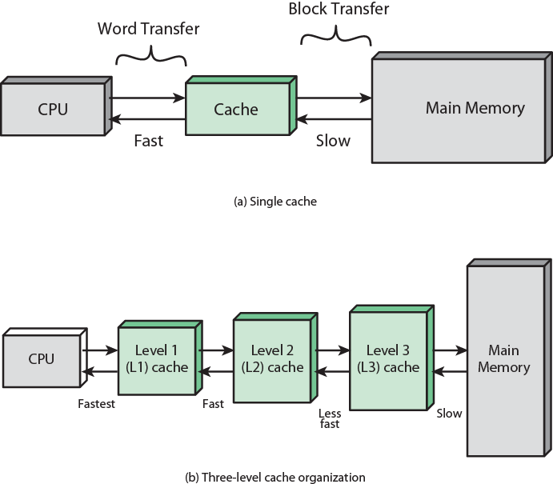
Cache and Main Memory

Slide 25
Cache
Small amount of fast memory
Sits between normal main memory and CPU
May be located on CPU chip or module

Slide 26
Cache operation – overview
CPU requests contents of memory location
Check cache for this data
If present, get from cache (fast)
If not present, read required block from main memory to cache
Then deliver from cache to CPU
Cache includes tags to identify which block of main memory is in each cache slot

Slide 27
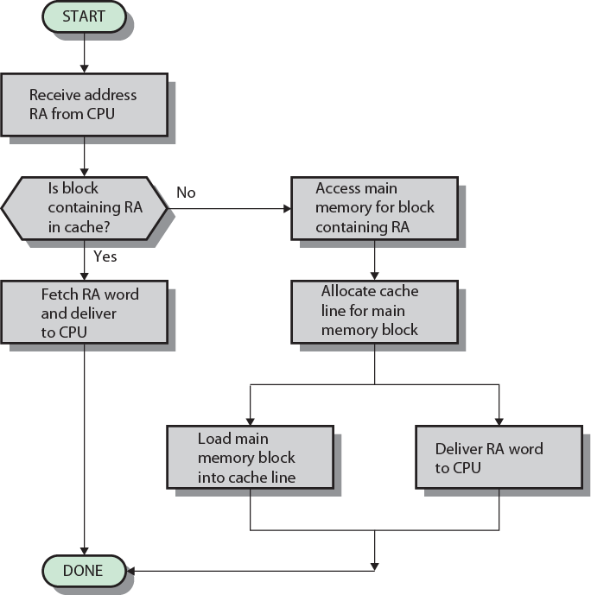
Cache Read Operation - Flowchart

